Slide 1
Foreign Languages Department,
Jiangsu Second Normal University

Slide 2
2016-2017
Cross-Cultural
1
Communication
2016
New Target College English Readings in Western Culture
Author：Fu Ying

Slide 3
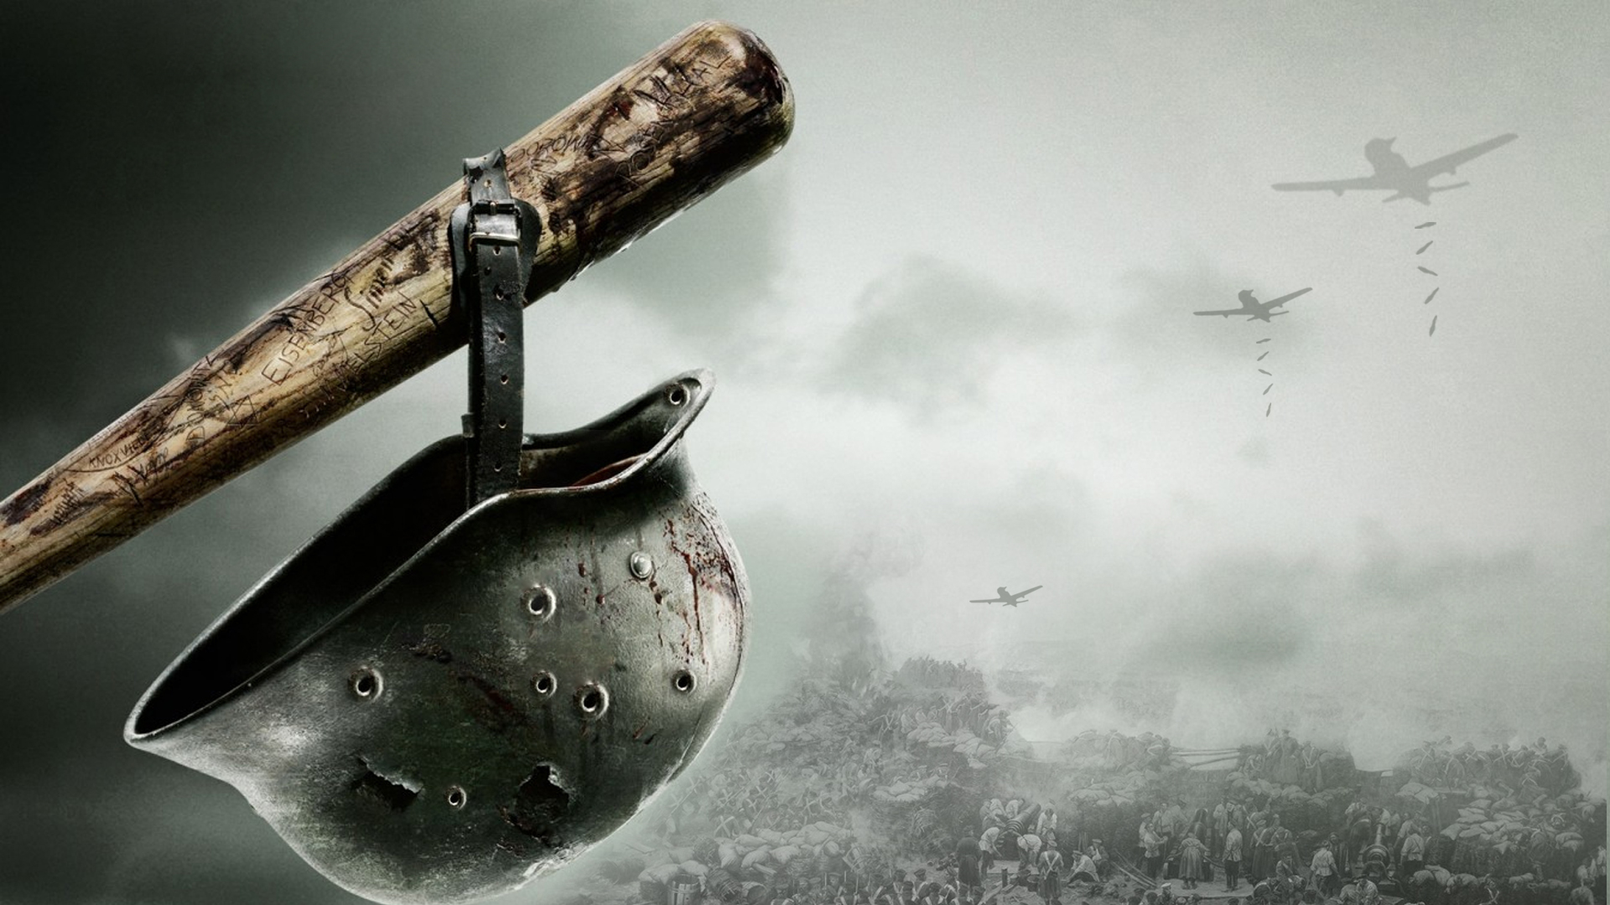
Unit 12
Reading A
Two World Wars
From D-Day to VE Day

Slide 4
UNIT 12
TWO WORLD WARS
From D-Day to VE Day
Step
Lead-in
Reading A

Slide 5
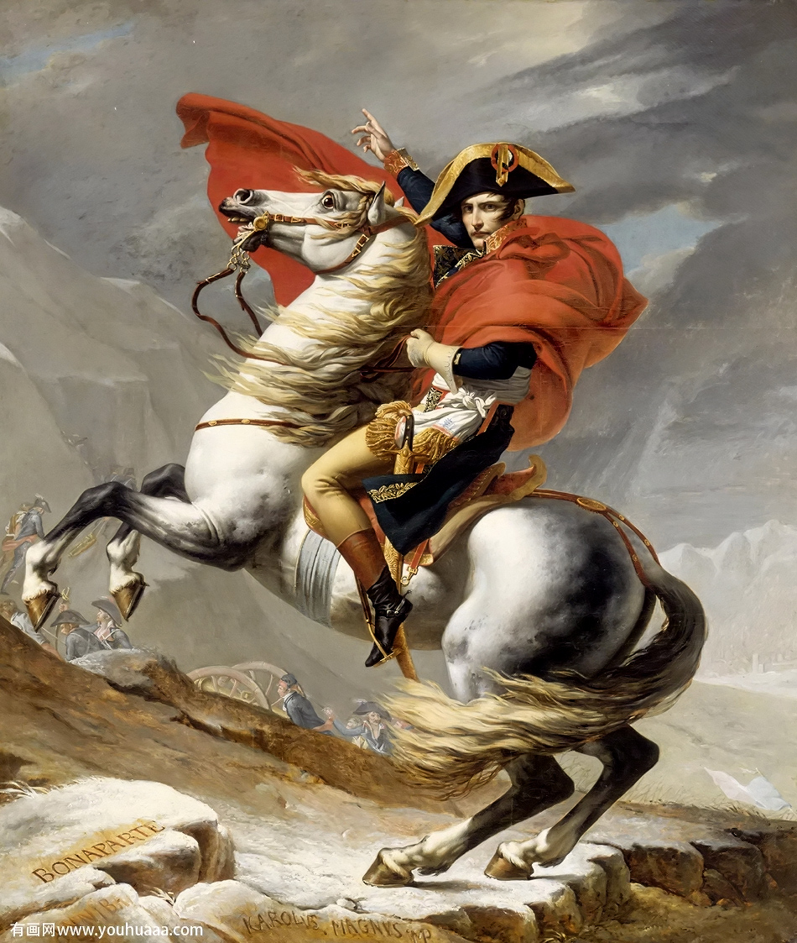
Napoleon Bonaparte
Napoleon Bonaparte
——There is a moment in every battle at which the least maneuver is decisive and gives superiority as one drop of water causes overflow.

Slide 6
UNIT 12
TWO WORLD WARS
From D-Day to VE Day
Step
Guided Discussion
Reading A

Slide 7
Think over
1
Why was there WWII? And the causal relationship between WWI and WWII?
Why was Adolf Hitler so powerful to instigate Germans and built up the allied relationship with Italy and Japan?
How did the European countries change their attitude during WWII?
2
3

Slide 8
UNIT 12
TWO WORLD WARS
From D-Day to VE Day
Step
Guided Reading
Reading A

Slide 9
Three critical battles
Normandy landings
(June 6, 1944)
1
Arnhem Battle
(September 17-26,1944)
2
Ardennes Campaign
(December 16, 1944)
3

Slide 10
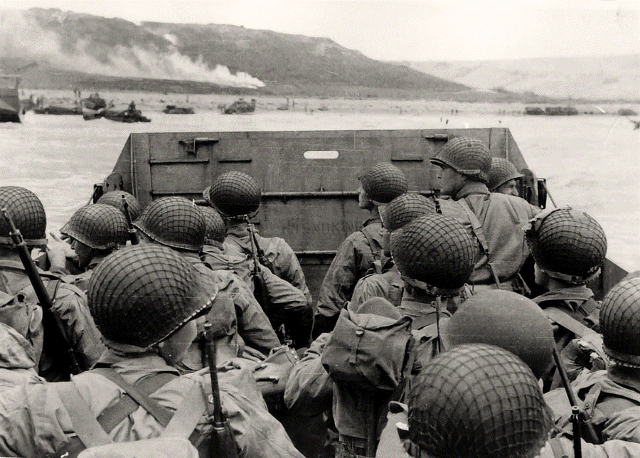
Battle Ⅰ
Normandy Landing

Slide 11
Title explanation

Slide 12
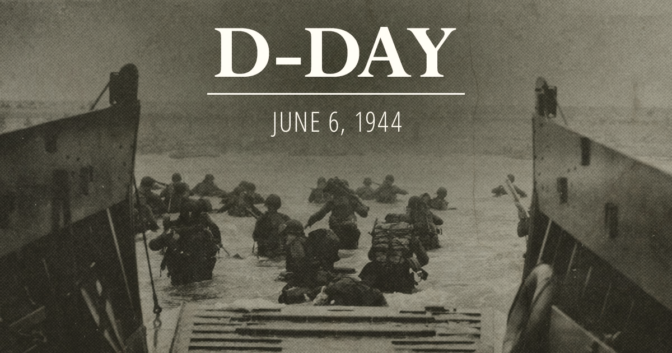
It in a military sense refers to the day on which an attack or operation is to be initiated. The best known D-Day is the day (June 6, 1944) of the Normandy landings, the result of which liberated mainland Europe from Nazi occupation during WWII.

Slide 13
It refers the Victory in Europe Day
VE Day

Slide 14
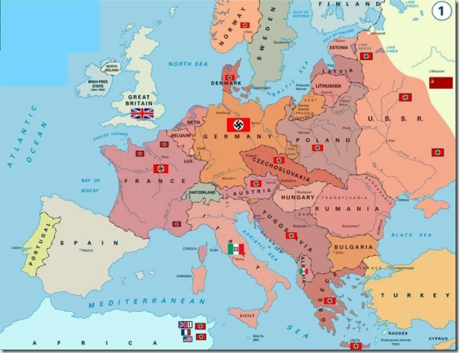
1941, Russia
1940, Denmark
1939, Czechoslovakia,
Poland,
1939, Czechoslovakia,
Poland,
Nazi occupied and
conquered countries
1940, France
1941, Greece
1938， Austria

Slide 15
D-Day
Liberation of German-occupied northwestern Europe from Nazi control
Normandy Landing on June 6, 1944, the largest seaborne invasion in history
Contributed to the Allied victory on the Western Front.
June 5, 1944, Dwight Eisenhower

Slide 16
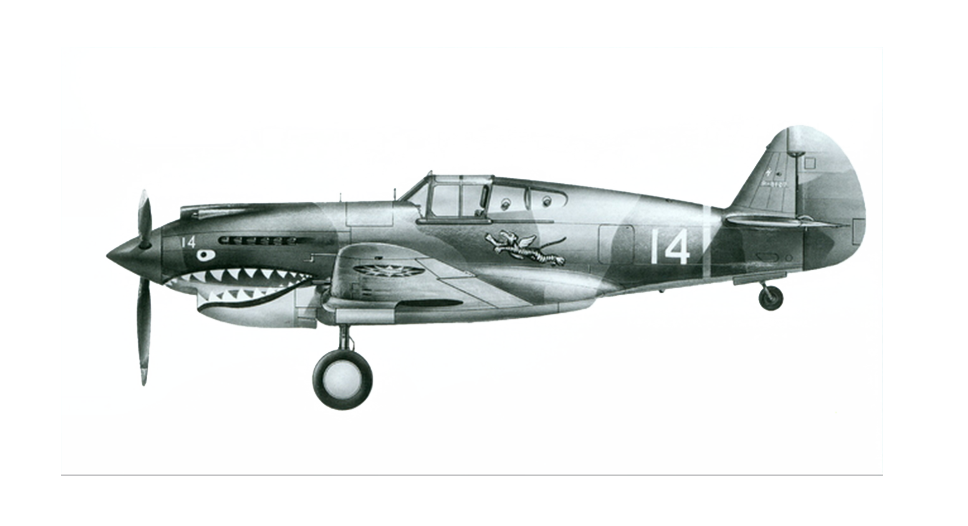
D-DAY
1
Extensive aerial and naval bombardment and an airborne assault
Responsive 01
2
24,000 American, British, and Canadian airborne troops shortly after midnight
Responsive 02
3
Responsive 03
Began landing on the coast of France at 06:30
4
Responsive 04
Utah, Omaha, Gold, Juno, and Sword--50-mile (80 km) stretch of the Normandy coast

Slide 17
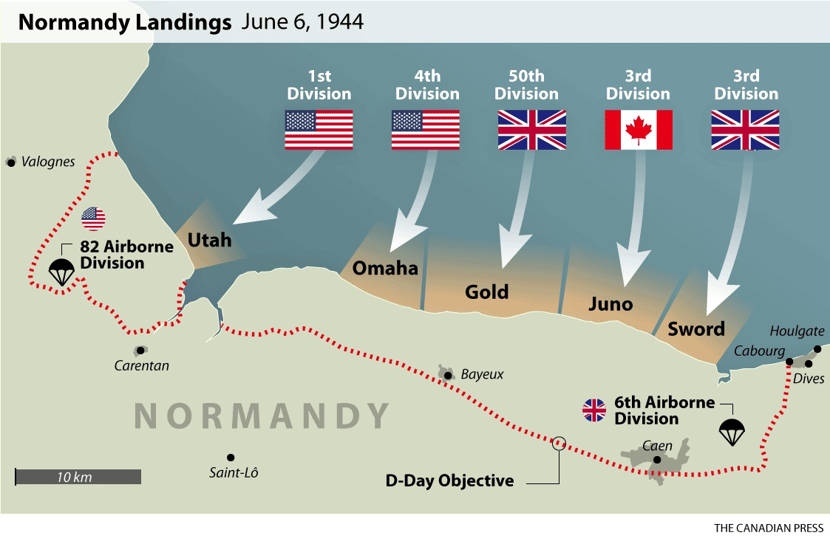
The English Channel
Most Germans expected the Allies would attack at Calais in France. But they were wrong. Eisenhower planned to strike at the French coast of Normandy across the English Channel.
Five important landing sites
Normandy

Slide 18
Normandy

Slide 19
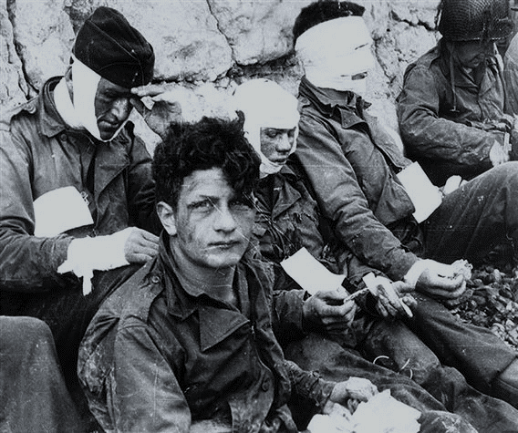
No
War
is
romantic

Slide 20
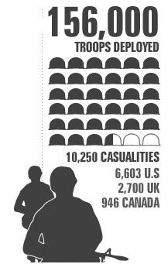
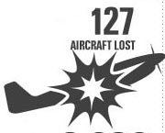
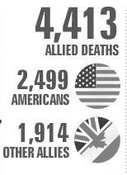
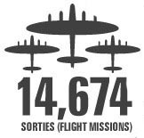
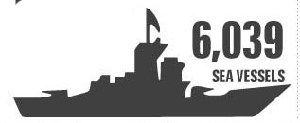
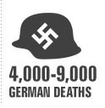
D-Day in Numbers

Slide 21
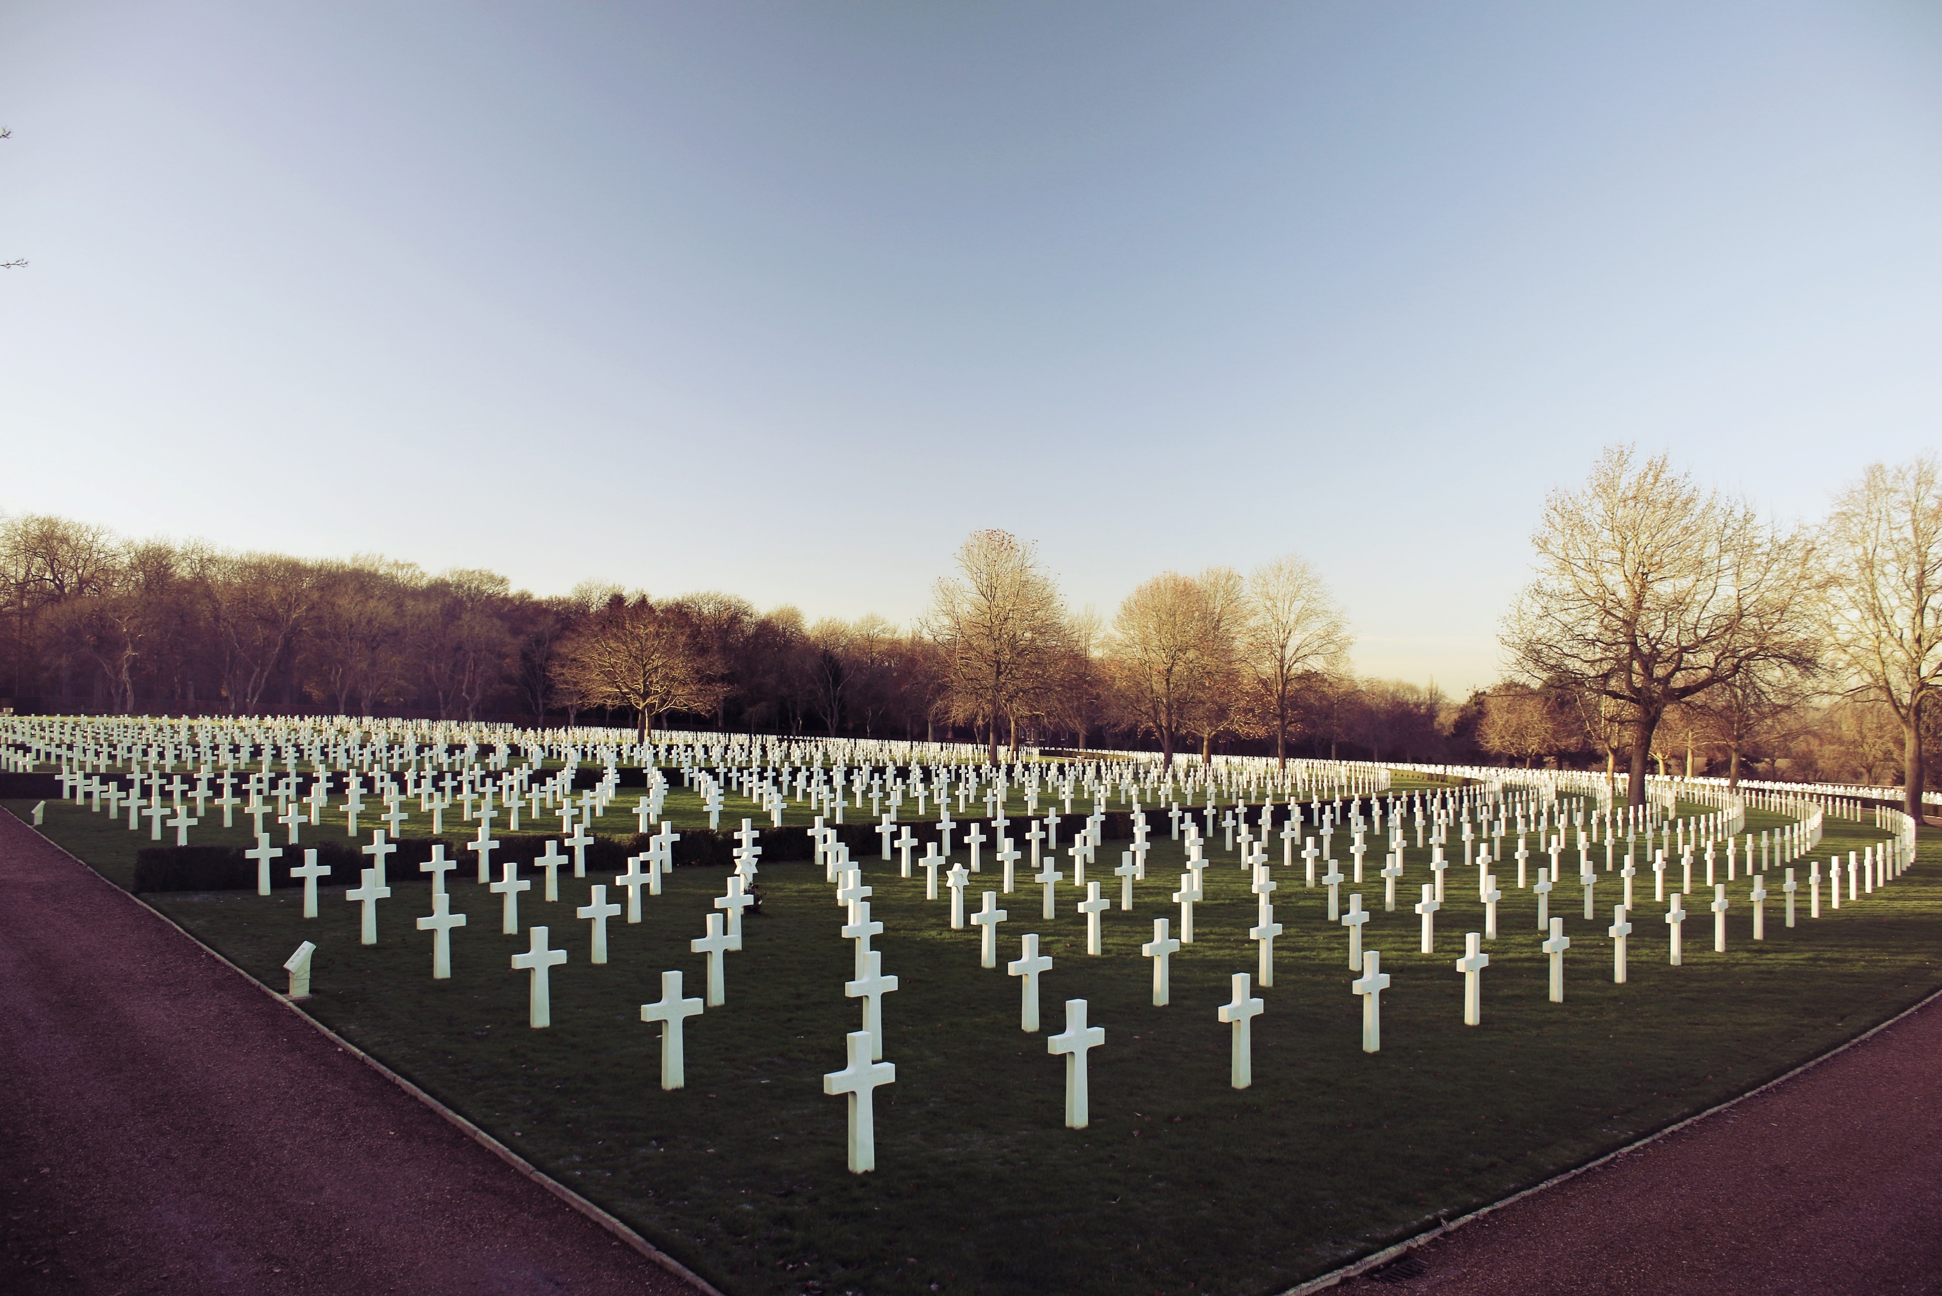

Slide 22
Battle Ⅱ
Arnhem Battle

Slide 23
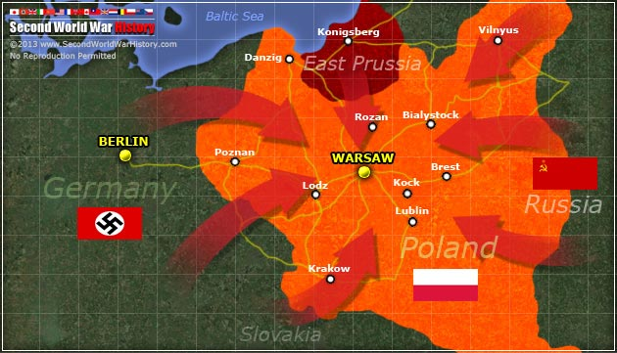
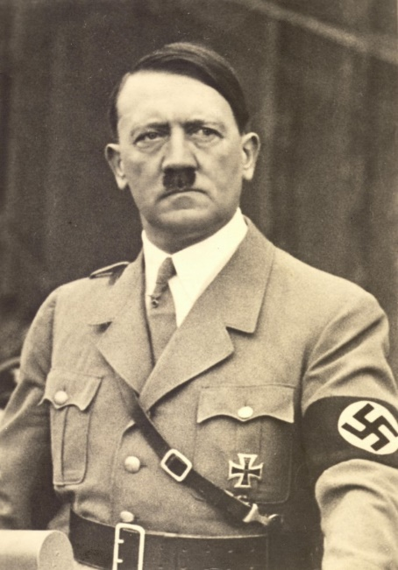
The Soviets attacked Germany from the east in 1944
In 1944, Soviet forces recaptured Volgograd, Moscow, St. Petersburg, then entered Finland, Poland and Romania
Germany
Russia
Poland
Adolf Hitler was almost assassinated by several Germany military officials

Slide 24
Late August, Paris Belgium—Belgian port of Antwerp: easier to send supplies and fuel to troops
– General Charles de Gaulle
Germany’s brief victory stopped the Allied invasion
Late August, Paris – General Charles de Gaulle
Netherlands—stopped by the Germans—British “Red Devil” was defeated-- Arnhem Battle

Slide 25
Arnhem Battle
The Battle of Arnhem was a major battle of WWII fought in and around the Dutch towns of Arnhem from 17–26 September 1944. An airborne landing at Arnhem ,code-named Operation Market Garden, was a plan to end World War Two early. But it failed for German forces’ defeating.

Slide 26
At Arnhem, the British met much stiffer opposition than they had been lead to believe. For the shortage of aircraft and the heavy foggy weather, the British paratroopers exposed to a German attack, and finally failed to secure the southern end of the bridge.
The idea for an airborne landing on Arnhem came from Field Marshall Bernard Montgomery who reckoned on dropping a large airborne force into Holland. The attack had to be planned in just six days.
By September 1944, a bold plan was proposed to head north through the Dutch ,bypassing the German Siegfried Line defenses and opening a route into the German industrial heartland of the Ruhr, codenamed Market Garden.
Operation Market Garden began on Sunday morning, September 17th, 1944. However, by the 18th September, fog had played its part.
German forces defeated British “Red Devil”.

Slide 27
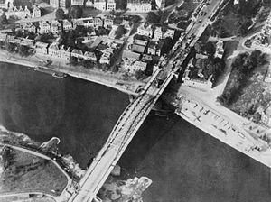
The Arnhem road bridge

Slide 28
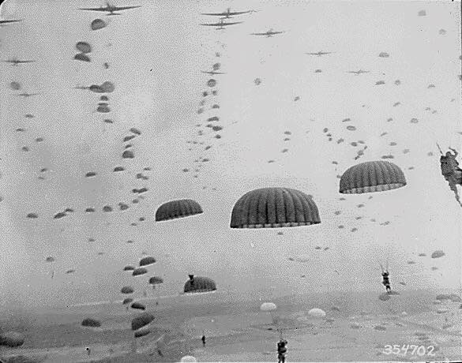
The airbornetroops
Killed in action or died of wounds--1,485
Captured or missing-- 6,525

Slide 29
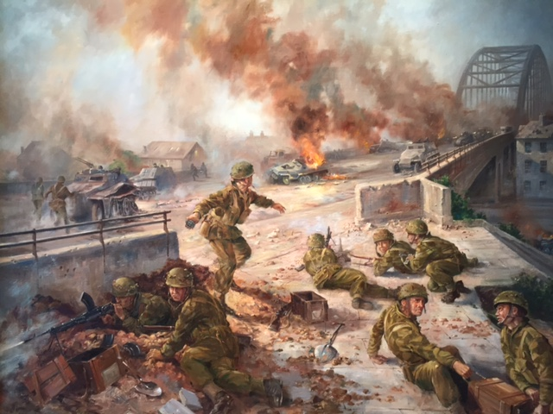
German forces
defeated British “Red Devil”.
The British met much stiffer opposition at the Arnhem road bridge

Slide 30
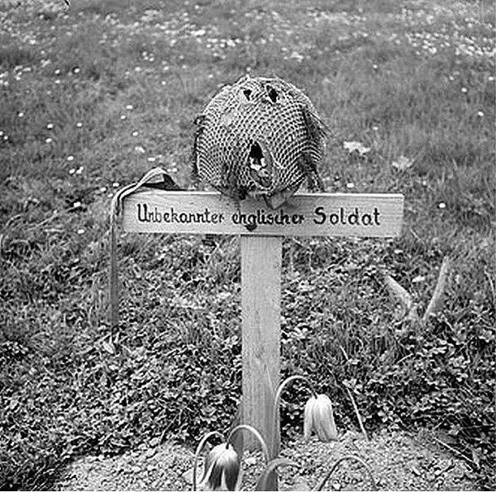
The grave of an unknown British airborne soldier at Arnhem, photographed by a British Army sergeant after the liberation of the city in 1945.

Slide 31
Battle Ⅲ
Ardennes Campaign

Slide 32
Ardennes Campaign
The Germans quickly broke through the American line for the weather was so bad that Allied planes could not drop bombs on the German forces.
The battle ended in a great defeat for Hitler and the Germans, which lost more than 100,000 men and great amounts of supplies.
Soviet and American met in victory – the war in Europe was ended.
By late February, 1945, the Germans were forced to retreat across the Rhine River. American forces led by General Patton drove deep into the German heartland.
Hitler suicided while Berlin was destroyed. Then the German army surrendered officially.
Hitler planned a surprise attack in December 1944, aiming at breaking through the Allied line, separating the Allied forces, and regaining control of the war.
Allied forces from nearby areas raced to the battle-front to help.

Slide 33
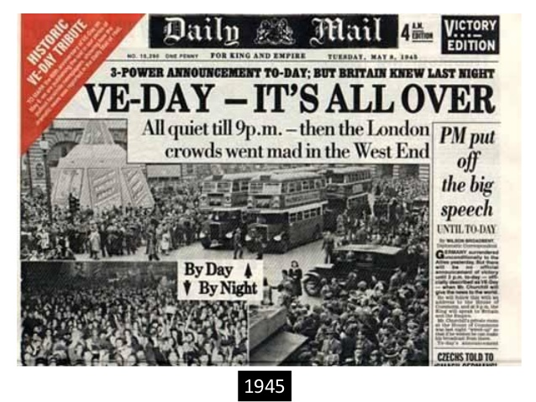
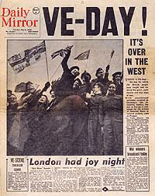
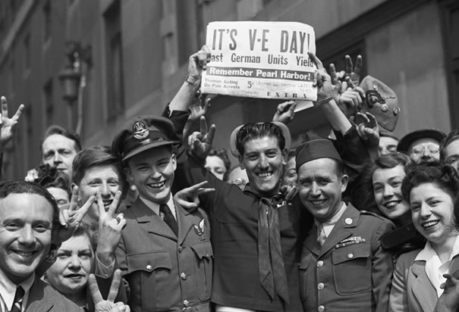
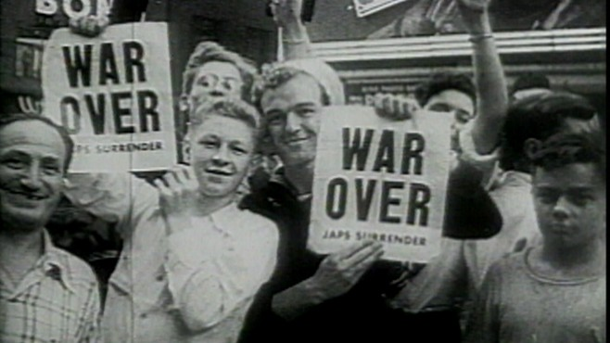
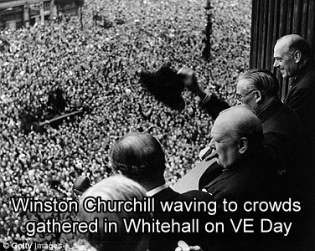
VE Day: It refers the Victory in Europe Day.
But two facts made the celebration less joyful than they might have been.

Slide 34
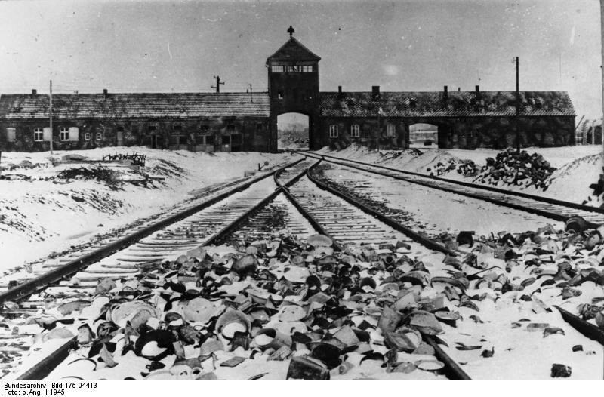
One fact was the German death camps;
Almost 17,000,000 people were killed by Nazi.

Slide 35
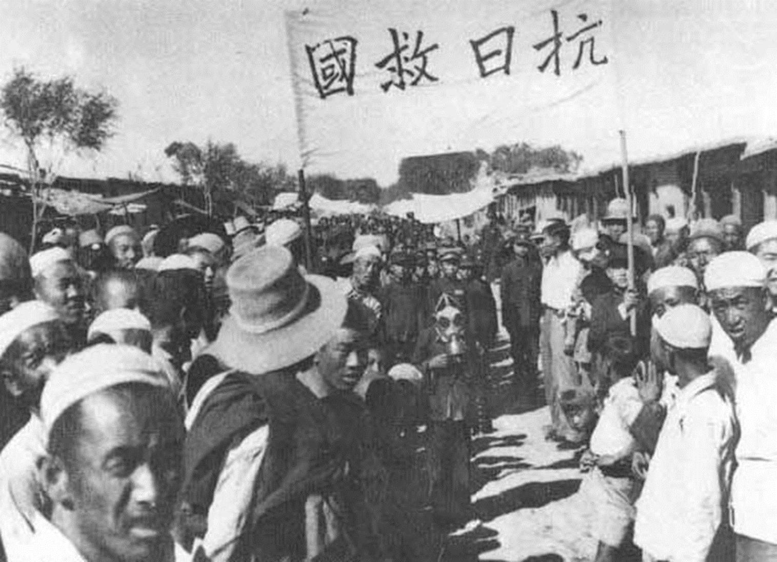
The second was the Pacific war had not ended;
The Anti-Japanese War was still in progress …

Slide 36
TWO WORLD WARS
Step
From D-Day to VE Day
Comprehension Check
UNIT 12
Reading A

Slide 37
True or False statement:
F
( ) 1. The greatest invasion, D-Day, took place as it had
been planned in spite of the bad weather.
( ) 2. German generals and military experts had never
imagined the Allies would attack Normandy.
( ) 3. One advantage of the Allied troops over the Germans
was that the Allied soldiers had greater numbers.
( ) 4. The Allied forces attacked the Germans from the east
while the Soviet trips moved in from the west.
( ) 5. The discovery of the terrible German death camps
made the defeat of Germany less joyful than they might
have been.
T
T
F
T

Slide 38
UNIT 12
TWO WORLD WARS
From D-Day to VE Day
Step
Homework
Reading A

Slide 39
Preview
Reading B
and think about how America behaved in WWI and the influences brought on the country by its participation in the war.

Slide 41
THANK YOU
Author:
FOR WATCHING
Fu Ying
New Target College English Readings in Western Culture

